Slide 1
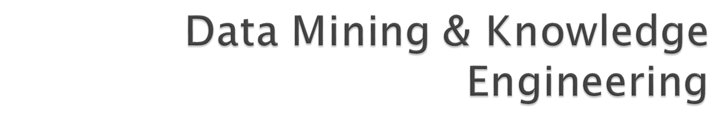
Lecture 3
Data Mining Algorithms for Classification

Slide 2

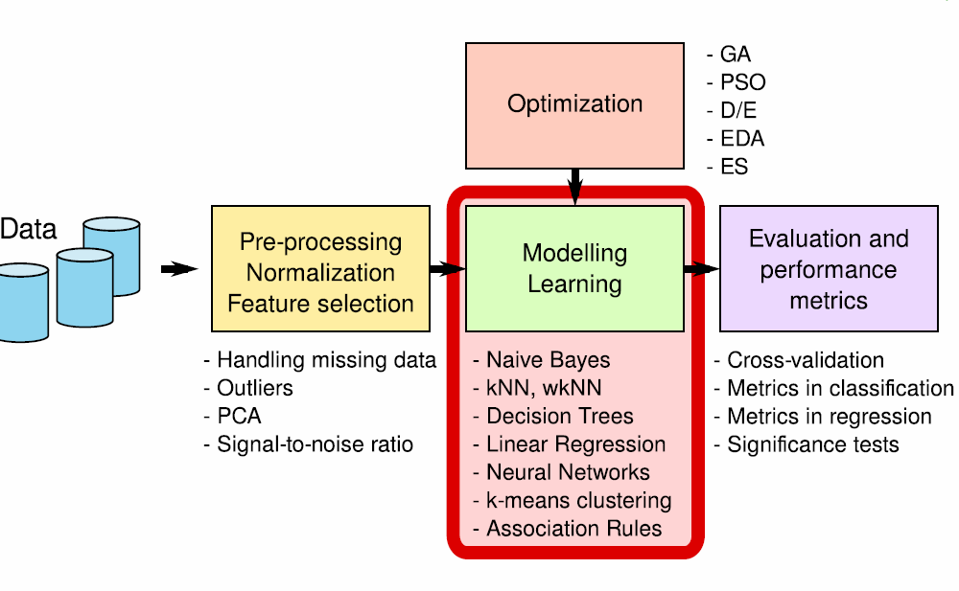

Slide 3

Simple algorithms often work surprisingly well
Many different kinds of simple structure exist:
  One attribute might do all the work
  All attributes might contribute independently with equal importance
Success of method depends on the domain!

Slide 4
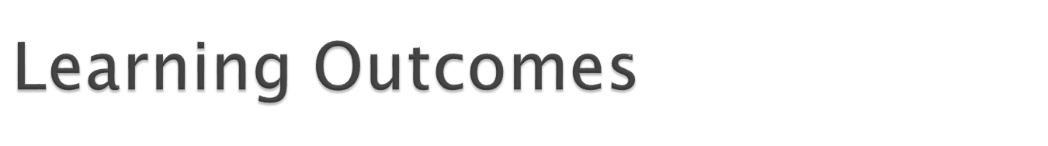
Examine the algorithms used in popular classification schemes
  1R
  Naïve Bayes
  Nearest Neighbour
  Decision Trees

Slide 5

1R: learns a 1-level decision tree
In other words, generates a set of rules that all test on one particular attribute
One branch for each of the attribute’s values
Each branch assigns most frequent class
Error rate: proportion of instances that don’t belong to the majority class of their corresponding branch
Choose attribute with lowest error rate

Slide 6
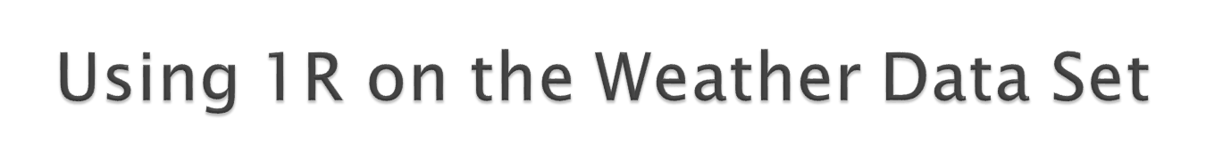
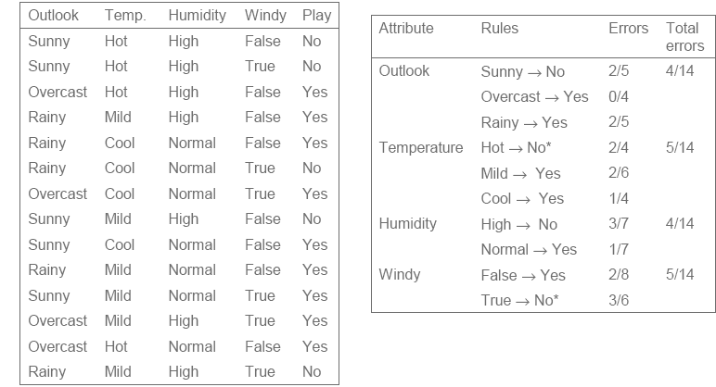

Slide 7

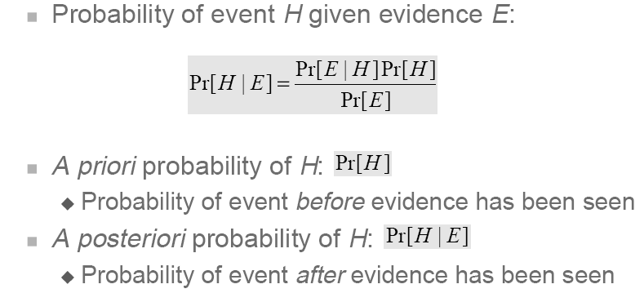
Opposite of 1R – considers all attributes
Assumes that all attributes are statistically independent of each other – not always true
However, most efficient classification technique as it makes only one pass through training data
Uses Bayes theorem:

Slide 8
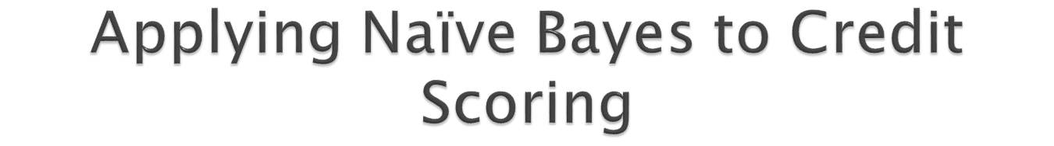
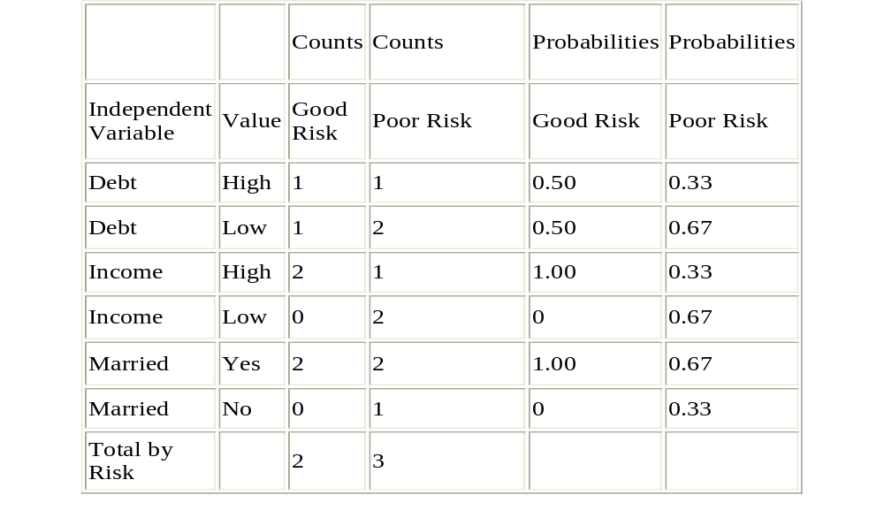

Slide 9

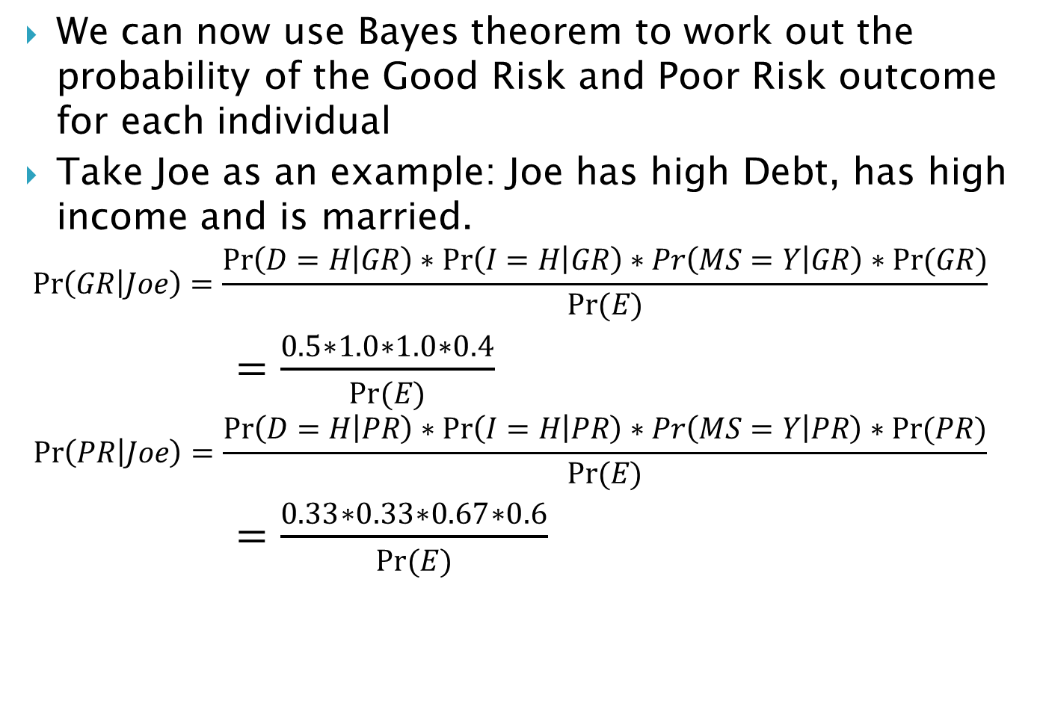
Since Pr(GR|Joe) > Pr(PR|Joe), Joe is classified as a good risk applicant

Slide 10

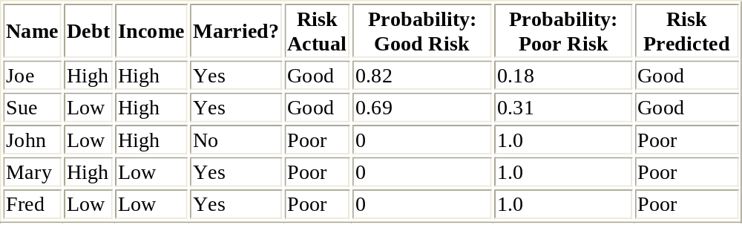
Likewise, classification for 4 further individuals appear in the table below

Slide 11

Models developed with Naive Bayes have good explanatory power, just as with Decision Trees
In the credit scoring problem the Income and Marital Status attributes essentially determines the risk factor for a given individual (Why?)
It is also true that the typical profile of a good risk applicant is someone who is married and has high income

Slide 12
Robust technique as it can deal with unknown/missing values
Two types of scenarios for missing values:
  Missing values in the training dataset:
    Can be handled by not including these instances in the probability estimate calculations.
  Missing values in the instance to be classified
    This needs care, if just one of the attribute values are missing, then the corresponding conditional probability can be set to 1 for ALL class outcomes and result will thus not be biased.

Slide 13
Continuous (ratio) data can be handled by binning – done automatically by most DM products (including Weka)
An alternative scheme for continuous data is to compute probabilities using the Gaussian (Normal) distribution
Naïve Bayes works well in practise even though attributes may not be statistically independent
In cases where a large number of attributes are dependent on each other a more advanced version called Bayes Net should be used.

Slide 14

To classify, an applicant, we make use of the previous table to work out Pr (Good Risk/Evidence) for that applicant
In this example the hypothesis H can take one of two values: Good Risk or Poor Risk
The evidence E is in three parts:
  E1, which corresponds to Debt level
  E2, corresponding to Income level
  E3, corresponding to Marital Status
From probability theory we have:
  Pr(E1, E2, E3)|H) = Pr(E1|H)*Pr(E2|H)*Pr(E3|H) under the assumption that E1, E2 and E3 are all independent of each other

Slide 15
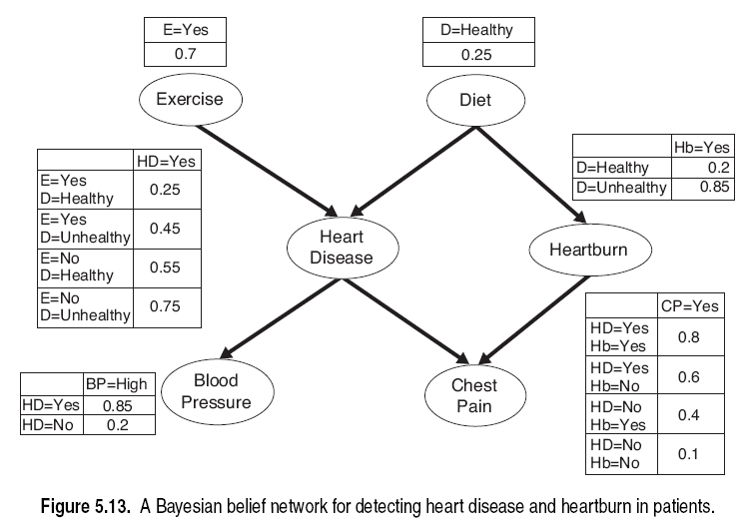
Bayesian Networks
P(HeartDisease=“No”|Exercise=“no”, Diet =“Healthy”) =
1 - P(HeartDisease=“Yes”|Exercise=“no”, Diet =“Healthy”) =1- 0.55 = 0.45
P(HeartBum=“yes”|
Dieta=“Healthy”) = 0.2

Slide 16

Normal procedure: top down in recursive divide and conquer fashion
First: attribute is selected for root node and branch is created for each possible attribute value
Then: the instances are split into subsets (one for each branch extending from the node)
Finally: procedure is repeated recursively for each branch, using only instances that reach the branch
Process stops if all instances have the same class

Slide 17
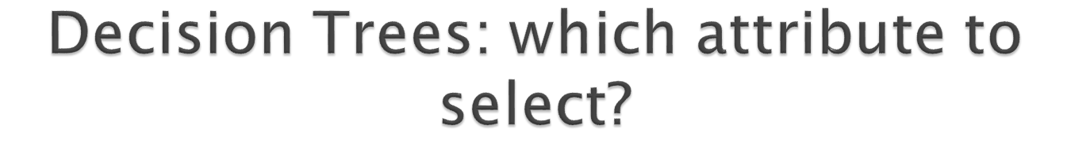
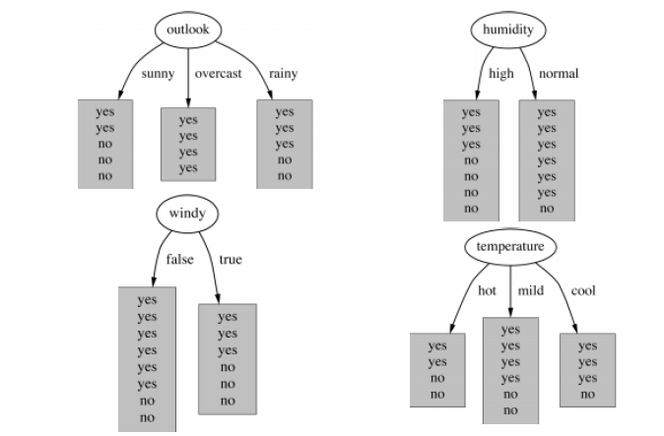

Slide 19
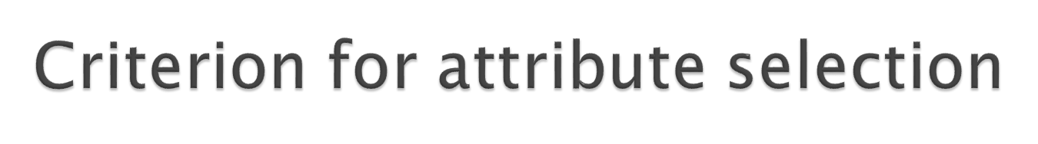
Which is the best attribute?
  The one which will result in the smallest tree
  Heuristic: choose the attribute that produces the “purest” nodes
Popular purity criterion: information gain
  Information gain increases with the average purity of the subsets that an attribute produces
Strategy: choose attribute that results in greatest information gain

Slide 20
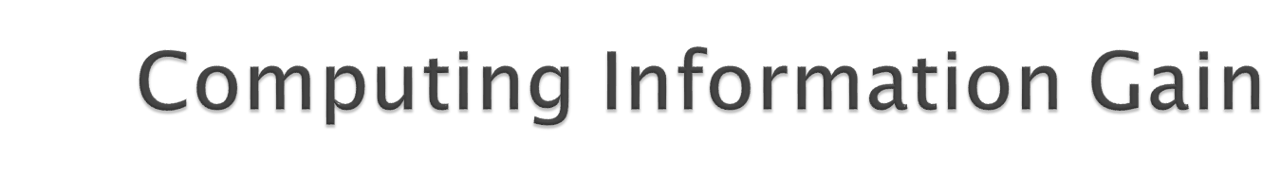
Information is measured in bits
  Given a probability distribution, the info required to predict an event is the distribution’s entropy
  Entropy gives the information required in bits (this can involve fractions of bits!)
Formula for computing the entropy:
Where p₁, p₂, …., p_{n} denote the probability of occurrence of outcomes for class 1, 2, …, n respectively

Slide 21

“Outlook” = “Sunny”:
“Outlook” = “Overcast”:
“Outlook” = “Rainy”:
Expected information for attribute:

Slide 22

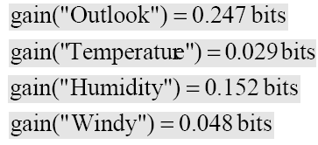
Information gain: information before splitting – information after splitting
gain(“Outlook”) = info([9,5]) – info([2,3],[4,0],[3,2]) = 0.940-0.693
Information gain for attributes from weather data:

Slide 23

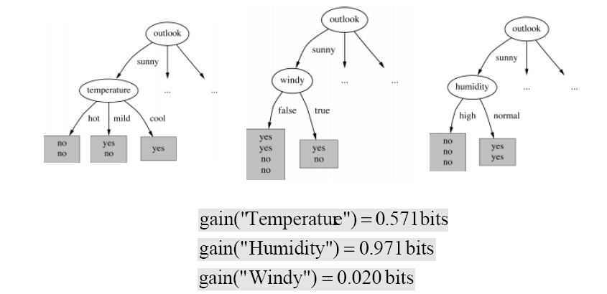

Slide 24
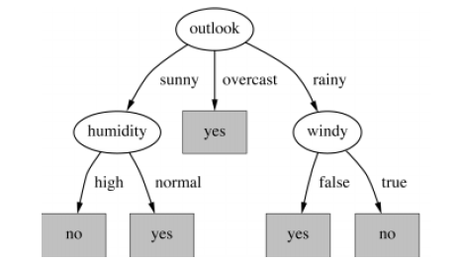
Note: not all leaves need to be pure
Some leaf nodes will have instances belonging to more than one class – in this case the leaf node is labelled with the majority class
Splitting stops when data can’t be split any further – when we run out of attributes to split on or the number of instances at the node to be split is less than a specified minimum number (MinNumObj in Weka)

Slide 25

Stop expanding a node when all the records belong to the same class
Stop expanding a node when all the records have similar attribute values
Early termination (to be discussed later)

Slide 26

Advantages:
  Inexpensive to construct
  Extremely fast at classifying unknown records
  Easy to interpret for small-sized trees
  Accuracy is comparable to other classification techniques for many data sets

Slide 27

Underfitting and Overfitting
Missing Values
Costs of Classification

Slide 28

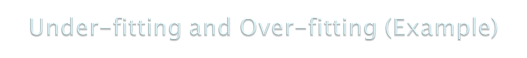

500 circular and 500 triangular data points.
Circular points:
0.5 ≤ sqrt(x₁²+x₂²) ≤ 1
Triangular points:
sqrt(x₁²+x₂²) < 0.5 or
sqrt(x₁²+x₂²) > 1

Slide 29

Two problems that can arise with models developed with Data Mining are: Overfitting and Underfitting
Underfitting occurs when the model has not fully learned all the patterns in the data, resulting in poor prediction accuracy (test accuracy).
Underfitting is generally caused by lack of sufficient volume of data –training dataset is too small
In the case of a Decision Tree method the tree developed is not of sufficient depth and size to learn all the patterns present in the data

Slide 30

With Overfitting the model’s learns the patterns in the training data very well but the model leant cannot predict newly arriving data well
In other words accuracy on training dataset is high but accuracy drops drastically on newly arriving data – training set accuracy >> test set accuracy
In the case of the Decision tree method the tree developed is too detailed (too large in size)
Overfitting is generally caused by:
Noise (errors in assigning class labels) in the training dataset
Lack of sufficient data to capture certain types of patterns

Slide 31
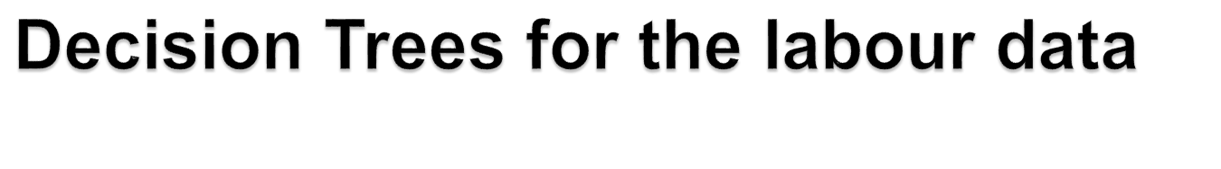
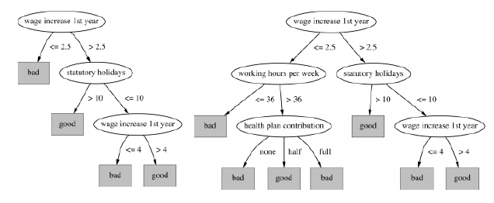

Slide 32




Overfitting

Slide 33


Decision boundary is distorted by noise point

Slide 34
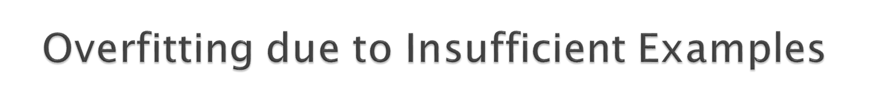

Lack of data points in the lower half of the diagram makes it difficult to predict correctly the class labels of that region
- Insufficient number of training records in the region causes the decision tree to predict the test examples using other training records that are irrelevant to the classification task

Slide 35

Overfitting results in decision trees that are more complex than necessary
Training error no longer provides a good estimate of how well the tree will perform on previously unseen records
Need new ways for estimating errors

Slide 36
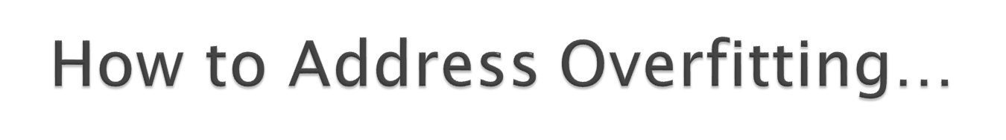
Post-pruning
  Grow decision tree to its entirety
  Trim the nodes of the decision tree in a bottom-up fashion
  If generalization error improves after trimming, replace sub-tree by a leaf node.
  Class label of leaf node is determined from majority class of instances in the sub-tree

Slide 37

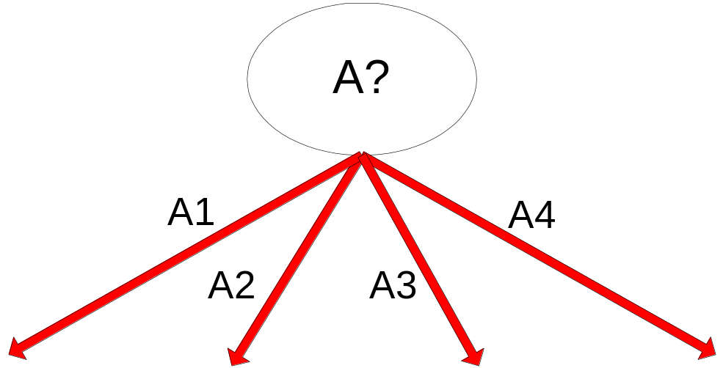
Training Error (Before splitting) = 10/30
Pessimistic error = (10 + 0.5)/30 = 10.5/30
Training Error (After splitting) = 9/30
Pessimistic error (After splitting)
= (9 + 4 × 0.5)/30 = 11/30
PRUNE!
Weka uses this procedure when the “unpruned” parameter is set to False
Class = Yes | 20
Class = No | 10
Error = 10/30
Class = Yes | 8
Class = No | 4
Class = Yes | 3
Class = No | 4
Class = Yes | 4
Class = No | 1
Class = Yes | 5
Class = No | 1

Slide 38

Algorithm for top-down induction of decision trees (“ID3”) was developed by Ross Quinlan
  ID3 only deals with nominal attributes
  Led to development of C4.5, which can deal with numeric attributes, missing values, and noisy data
Similar approach: CART
There are many other attribute selection criteria! (but with almost no difference in accuracy of result.)

Slide 39

Data Mining: Practical Machine Learning Tools and Techniques (3rdedition) / Ian Witten, Eibe Frank; Elsevier, 2011, Chapter 4
Naive-Bayes and Nearest Neighbour Techniques, document available from AUT online

